Slide 1

Notes:
Hi everyone! My name is Giuseppe Porcelli and I’m a Solutions Architect at Amazon Web Services in Milan and this is Diego Natali, my colleague.
Today we are going to show you a demo of Amazon Translate providing high-quality on-demand translations with very low latencies.
”The Vintage Vehicles” is a mock e-commerce allowing to browse and simulate buying vintage vehicles. Users can add and translate product reviews in six languages which is the core feature of the application and the main purpose of the demo itself. They can also visually see the sentiment of each review if it has been written in either English or Spanish.
Making reviews accessible in the customer’s language of choice has the potential of significantly increasing conversion of customers you would have previously lost.

Slide 2












Amazon S3 bucket
Amazon Translate
Amazon Comprehend
Amazon Route 53
shinecommerce.cloud-oriented.com
translated review
review sentiment analysis
AngularJS SPA
& static contents
Amazon CloudFront
Amazon Kinesis Firehose
Amazon S3 bucket
product data
Amazon API Gateway
Amazon RDS
Client Browser
OAuth2 flow
cached translations
Amazon Cognito
Amazon DynamoDB
Notes:
Before diving deep into the demo, let’s take a look at the architecture.
The website is a JavaScript single-page application hosted on a public S3 bucket where we have enabled static website hosting and served through Amazon CloudFront, leveraging the proximity of the edge locations of the content delivery network.
We also use Amazon Route53 as both domain registrar and DNS service.
The JavaScript client can establish an OAuth2 flow with Amazon Cognito User Pools federated with Amazon Login which will issue the access tokens required to invoke certain API Gateway APIs.
The web page makes REST API calls to Amazon API Gateway which then invokes Lambda functions to implement operations like getting products, getting reviews, and translating reviews. Lambda functions interact with:
Amazon Translate, to translate reviews
Amazon Comprehend, to analyse the sentiment of reviews – you will have a training on Comprehend later today
Amazon Aurora MySQL as the main database of the application, storing product and review data
Amazon DynamoDB to cache translate reviews and avoid calling Amazon Translate for reviews that had already been translated into a target language
Amazon Kinesis Firehose to log translation and sentiment analysis data to Amazon S3

Slide 3
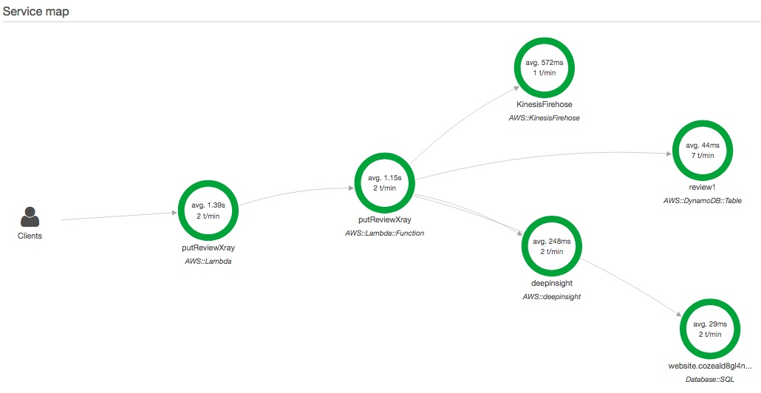
comprehend AWS::comprehend
Notes:
We also use AWS X-Ray to trace distributed execution flows and collect and monitor performance metrics.
Here we can see the trace of the putReview() Lambda function, used to add a new review or update an existing one.
It invokes Kinesis Firehose, Aurora MySQL and Amazon Comprehend. It also invokes DynamoDB as this is an update operation and we need to destroy any cached translation for that specific review.

Slide 4
DEMO
Notes:
Now I hand over to Diego, who will run a live demo.

Slide 5
THANK YOU!

